Slide 1
TULIP: Multi-camera 3D Precision Assessment of Parkinson’s Disease
Based on CVPR 2024 paper by Kyungdo Kim et al. (Duke University)
유수빈
2025.03.25

Slide 2
Introduction
Parkinson’s Disease (PD) causes progressive motor dysfunction.
The standard clinical assessment tool (UPDRS) is subjective and inconsistent
Inter-rater disagreement up to 53%
Difficult to capture subtle motor impairments
Purpose: Introducing a new 3D video dataset and ML-based PD evaluation method.
Notes:
파킨슨 병, 기존의 평가 방식, 논문의 목적

Slide 3
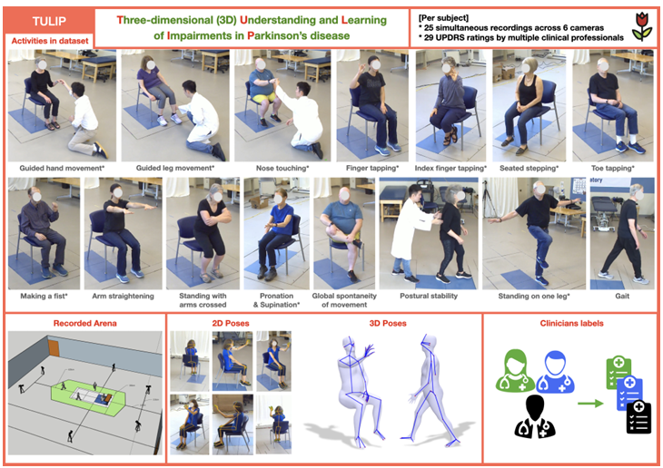
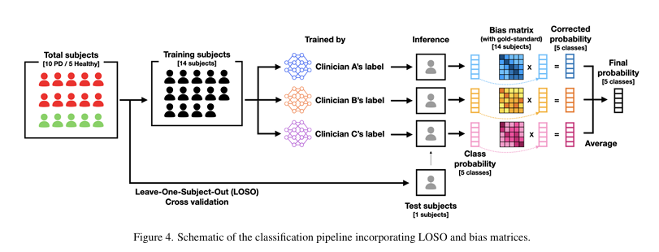
Overview
3D video dataset for UPDRS motor exam
15 subjects: 10 PD patients + 5 healthy controls
25 motor tasks (full UPDRS Part III) recorded
6 synchronized high-res RGB cameras
Pose estimation:
MediaPipe (hands), MMPose (full body)
Triangulated using Direct Linear Transformation (DLT)
labeled with expert consensus UPDRS scores
Notes:
데이터셋 구성, 어떻게 수집했는지, 무엇을 제공하는지 등

Slide 4
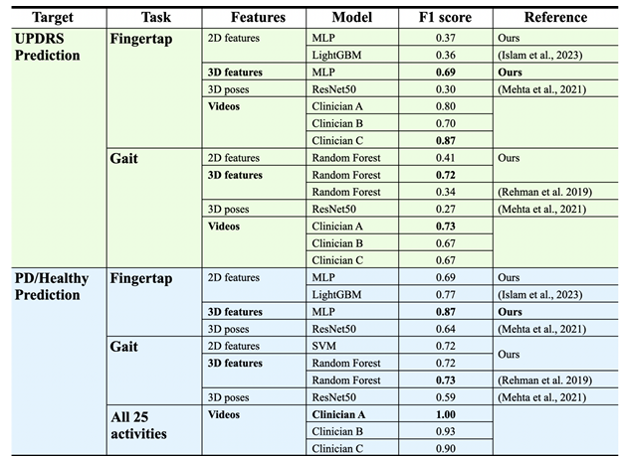
Usage
Example Tasks:
UPDRS score prediction (0-4 scale)
PD vs. Healthy subject classification
Key Results
Notes:
카메라 파라미터를 제공->3차원으로 backprojection -> 딥러닝 -> table1

Slide 5
Contributions
- First 3D multi-view dataset for full UPDRS motor exam
- Markerless, synchronized 6-camera setup with triangulated 3D skeleton
- Rich hand and gait features extracted from pose sequences
- ML models reached expert-level performance on some tasks
- Shows potential for objective PD evaluation at clinical scale
Notes:
해당 논문의 기여

Slide 6
Limitations
Small-scale dataset (15 subjects): limits generalizability
Data collecte in controlled lab: real clinics are more constrained
Only UPDRS tasks: lacks real-life activity monitoring
Currently uses supervised learning with UPDRS labels.
Notes:
한계점

Slide 7
Future work
Expand dataset across demographics and environments
- Explore unsupervised learning for new movement biomarkers
- Extend to other neurological disorders (e.g. Huntington’s)
Notes:
미래에 해볼 수 있는 것

